Slide 1
Food Delivery Time Prediction
PRESENTED BY: 1.Deepali Ghumare 2.Manisha Shinde 3.Pallavi Kale 4.Akash Satapute 5.Vaibhav Hegadkar

Slide 2
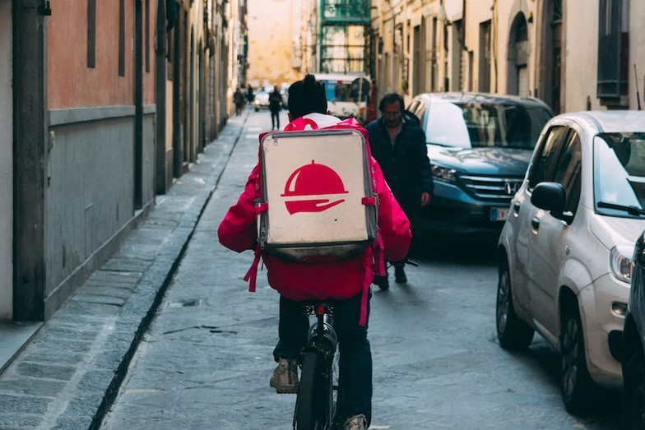
Introduction
Food delivery is a service that allows customers to order food from restaurants and have it delivered to their doorstep.
More businesses are moving online these days, and consumers are ordering online instead of traveling to the store to buy. Zomato and Swiggy are popular online platforms for ordering food products. Other examples are Uber Eats, Food Panda, and Deliveroo, which also have similar services. They provide food delivery options.
If the order is complete, a partner will pick up and deliver the meal to the given address via a delivery service. In online food-ordering businesses, delivery time is critical. As a result, estimated food delivery time prediction to reach the buyer’s location is critical.
Objectives
What factors can affect the time in delivering food from the restaurant to the destination location?
How much food delivery time prediction accuracy performance?

Slide 3
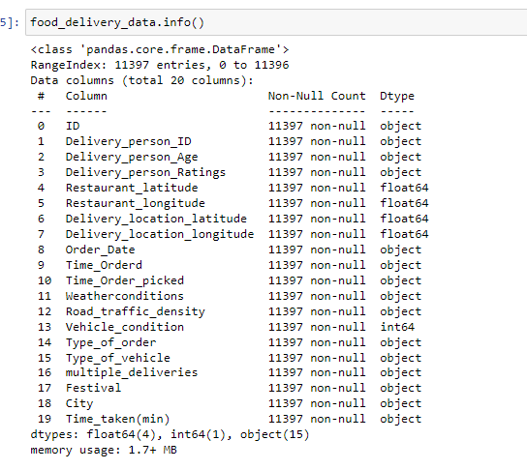
Data Preparation
General Info
Dataset consists 11397 rows and 20 columns. Then the dataset also consists of 5 numerical data and 15 categorical data
The problem faced is a regression problem, namely predicting the time needed to deliver food (Time taken)
There are no missing value, duplicated value, and odd data in this dataset
All numerical values contained in the dataset are quite reasonable

Slide 4
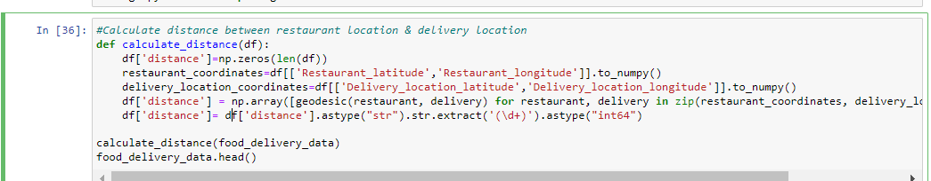
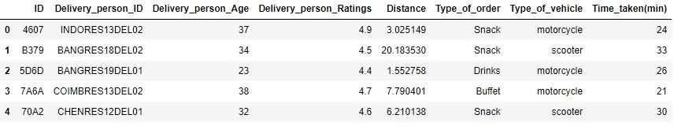
Data Preparation
geodesic function
geodesic function
Distance Calculation
To get the time needed to deliver food, the distance between the restaurant and the delivery location is needed. To get the required distance, we use geodesic function which can be used to calculate the distance between 2 locations by utilizing longitudes and latitudes.
Geodesic Function
Library- geopy.distance.geodesic

Slide 5
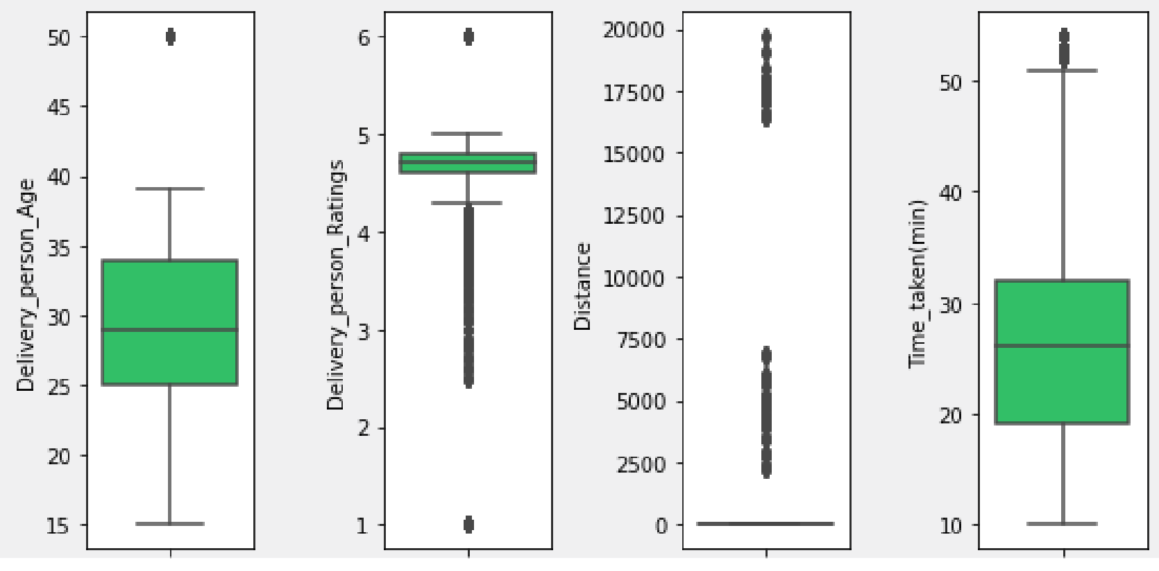
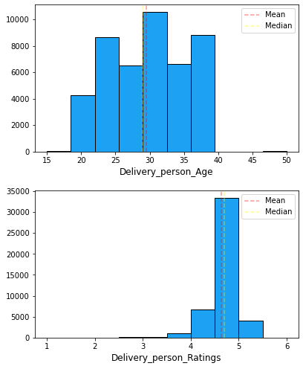
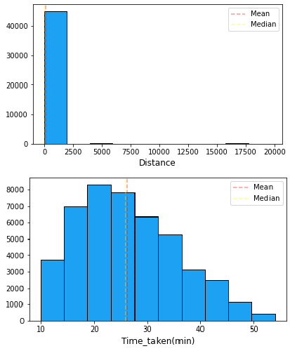
Exploratory Data Analysis
Univariate Analysis
Outliers Check
Extreme outliers at Delivery_person_Ratings column are on lower boundary (< 3.9), meanwhile distance column have extreme outliers in upper boundary (> 31.9)
Data Distribution Check
Delivery_person_Age and Time_taken(min) column have relatively normal data distribution Delivery_person_Ratings has negative skew data distribution, meanwhile distance column has positive skew data distribution

Slide 6
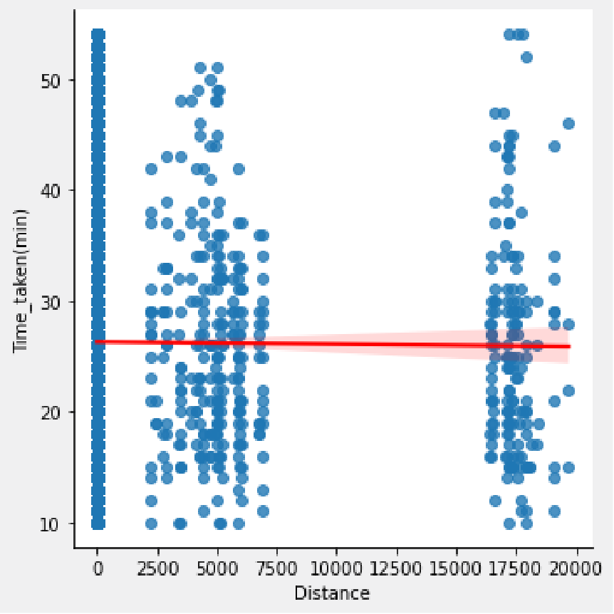
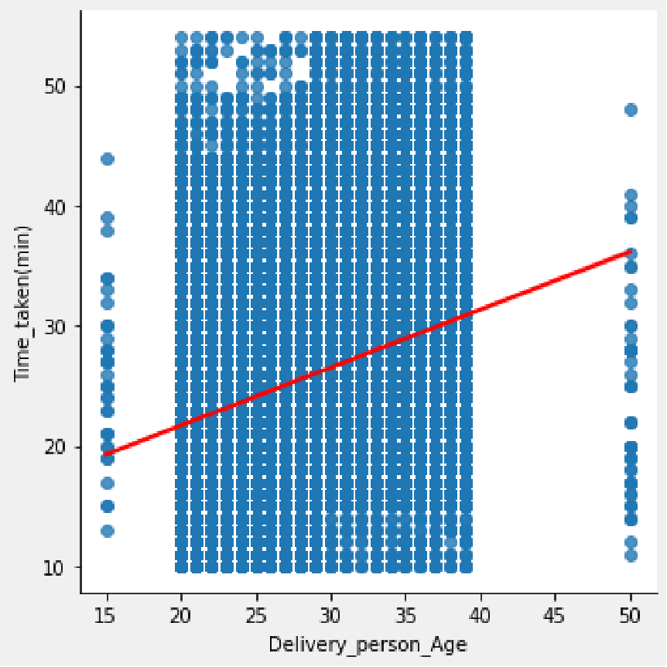
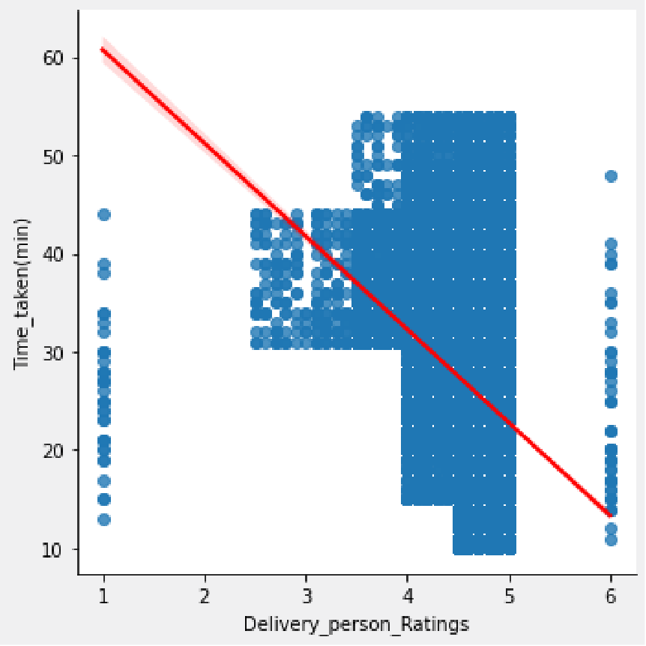
Exploratory Data Analysis
Bivariate Analysis
There is consistent relationship between the time taken and the distance travelled to deliver the food. It looks like majority food delivered within 25-27 minutes regardless of distance
There is a linear relationship between the time taken to deliver the food and the age of the person who delivering the food. It looks like person with the young age able to take less time than person with old age to deliver the food to customers
There is an inverse linear relationship between the time taken to deliver the food and the delivery person ratings. It looks like person with the higher ratings take a less time to deliver the food than person with low ratings

Slide 7
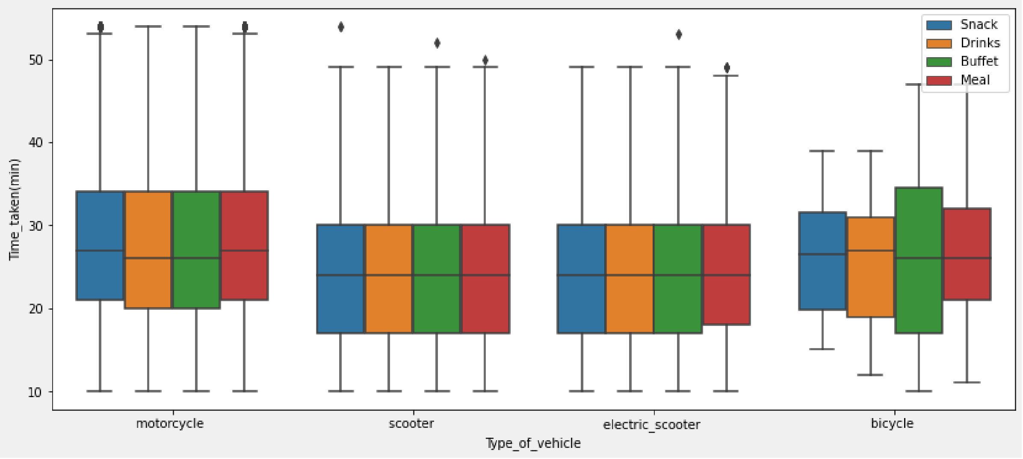
Exploratory Data Analysis
Bivariate Analysis
It looks like there is not much difference between the time taken depending on the vehicle they are driving and the type of food they are delivering

Slide 8

Data Pipeline Architecture
1. AWS Instance Creation:
Provision an Amazon EC2 instance to serve as the infrastructure for our data pipeline.
2. Zookeeper and Kafka Setup:
Install and configure Apache Zookeeper for distributed coordination.
Install and configure Apache Kafka for real-time data streaming.
3. S3 Bucket Creation:
Create an Amazon S3 bucket to store and manage data.
4.Python Data Loading:
Develop a Python script to load data into the S3 bucket.
Utilize the Boto3 library to interact with AWS services programmatically.
5.Athena Data Querying:
Set up an Amazon Athena database to query data stored in the S3 bucket using SQL-like queries.
Define tables and partitions to optimize query performance.
6.Power BI Connection through ODBC:
Install and configure the Athena ODBC driver on the EC2 instance.
Set up an ODBC data source to connect Power BI to Amazon Athena.

Slide 9
Feature Engineering
Initial Dataset
Feature Engineering
Unused Feature Drop Outliers Handling One Hot Encoding
Train Test Data Split (70:30)
Final Dataset (Train & Test Data)

Slide 10
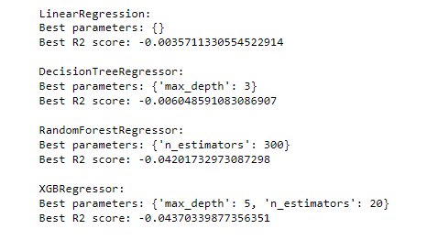


Modeling and Evaluation
Algorithms Training
Based on each RMSE (Root Squared Mean Error) result from
5 trained algorithms, best algorithm is XGBRegressor because have the smallest error than other algorithms. Performance of the best model will try to be improved with hyperparameter tuning
RMSE (Root Squared Mean Error) Formula

Slide 11
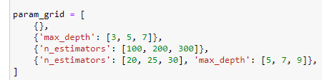

Modeling and Evaluation
Hyperparameter Tuning
Parameters to be tuned
Parameter tune using GridSearch CV
Best parameter
Model train using best parameter
Final model performance

Slide 12
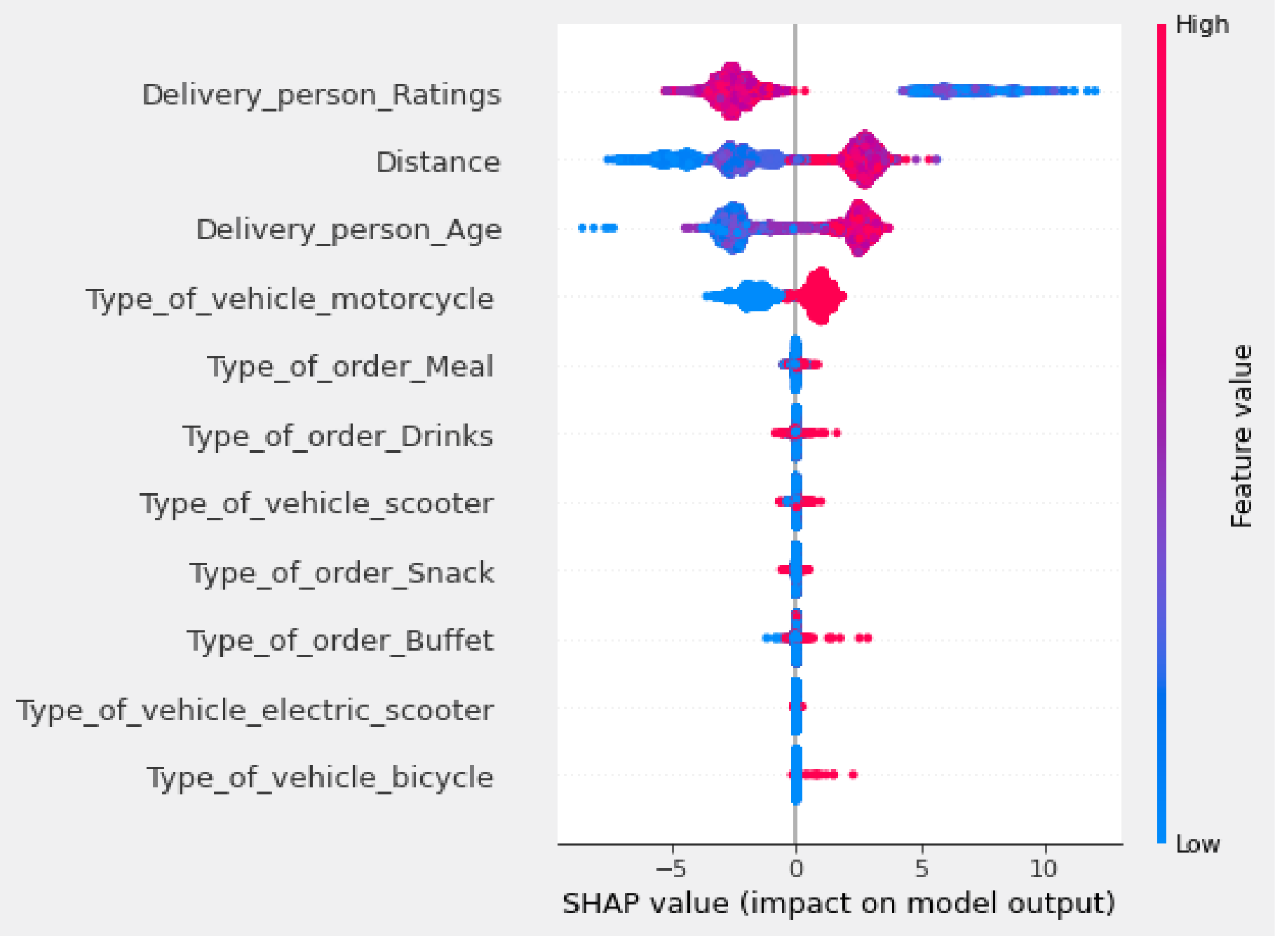
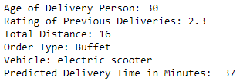
Modeling and Evaluation
Feature Importances
Delivery_person_Ratings variable become the most importance feature in this model, followed by Distance and Delivery_person_age variables. Then, we can see Delivery_person_Ratings variable has a negative contribution when its values are high, and a positive contribution on low values
Prediction on New Data

Slide 13
Conclusion and Recommendation
Conclusion
Rating of person in previous delivers become is the most influential factor on the delivery time of food to the destination location. Person with the higher ratings take a less time to deliver the food than person with low ratings
Model has RMSE score 7.28 and that means error between delivery time prediction and delivery time actual is 7.28 minutes
Recommendation
The rating obtained by the deliveryman is a representation of the deliveryman's performance in delivering food to the intended location in terms of delivery time. Of course this is a potential loss of customers if this continues to happen. Delivery time performance needs to be maintained so that the rating obtained is high and customer trust can still be maintained.
The RMSE value of the model can be used as a guarantee of delivery time performance which can be given to the customer so that as much as possible the delivery time is not more than the existing RMSE score (delay in delivery time of not more than 7.28 minutes).
Documentation :
Github Repository

Slide 14




THANK YOU
+62 878 7375 6695
foood@yahoo.com
fooddeliveryx456

